Slide 1
INTRODUCTION: EXPLORATORY DATA ANALYSIS (EDA).
EDA is all about understanding your data by employing summarizing and visualizing techniques.
At a high level the EDA can be performed in two folds, that is, univariate analysis and multivariate analysis.

Slide 2
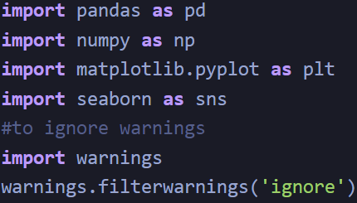
Import Python Libraries
Pandas and Numpy - used for data manipulation and numerical calculations
Matplotlib and Seaborn - used for data visualizations.

Slide 3
Reading Dataset
The Pandas library offers a wide range of possibilities for loading data into the pandas DataFrame from files like JSON, .csv, .xlsx, .sql, .pickle, .html, .txt, images etc.
Most of the data are available in a tabular format of CSV files.
Using the read_csv() function, data can be converted to a pandas DataFrame.

Slide 4

In this particular task, the data to predict Used car price is being used as an example. In this dataset, we are trying to analyze the used car’s price and how EDA focuses on identifying the factors influencing the car price. We have stored the data in the DataFrame data.

Slide 5



ANALYZING THE DATA
head() will display the top 5 observations of the dataset
tail() will display the last 5 observations of the dataset
info() helps to understand the data type and information about data, including the number of records in each column, data having null or not null, Data type, the memory usage of the dataset

Slide 6

Check for Duplication
nunique() based on several unique values in each column and the data description, we can identify the continuous and categorical columns in the data. Duplicated data can be handled or removed based on further analysis

Slide 7


Missing Values Calculation
isnull() is widely been in all pre-processing steps to identify null values in the data
In our example, data.isnull().sum() is used to get the number of missing records in each column
The below code helps to calculate the percentage of missing values in each column

Slide 8
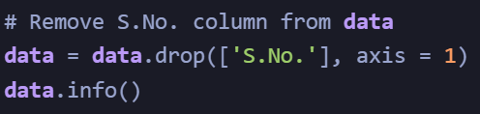
Data Reduction
Some columns or variables can be dropped if they do not add value to our analysis.
In our dataset, the column S.No have only ID values, assuming they don’t have any predictive power to predict the dependent variable.

Slide 9
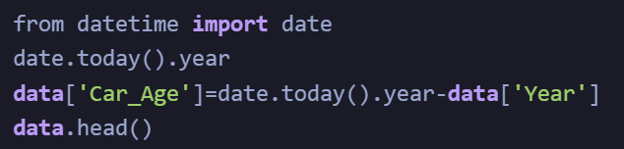
Creating Features
If we see the sample data, the column “Year” shows the manufacturing year of the car.
It would be difficult to find the car’s age if it is in year format as the Age of the car is a contributing factor to Car Price.
Introducing a new column, “Car_Age” to know the age of the car

Slide 10
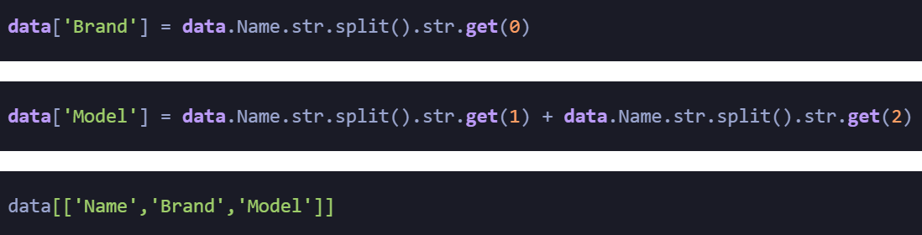
Since car names will not be great predictors of the price in our current data. But we can process this column to extract important information using brand and Model names. Let’s split the name and introduce new variables “Brand” and “Model”

Slide 11
Data Cleaning/Wrangling
Data Wrangling is a technique that is executed at the time of making an interactive model. In other words, it is used to convert the raw data into the format that is convenient for the consumption of data. This technique is also known as Data Munging.
Some names of the variables are not relevant and not easy to understand. Some data may have data entry errors, and some variables may need data type conversion. We need to fix this issue in the data.
In the example, The brand name ‘Isuzu’ ‘ISUZU’ and ‘Mini’ and ‘Land’ looks incorrect. This needs to be corrected

Slide 12



Slide 13
Statistics Summary
The information gives a quick and simple description of the data.
Can include Count, Mean, Standard Deviation, median, mode, minimum value, maximum value, range, standard deviation, etc.
Statistics summary gives a high-level idea to identify whether the data has any outliers, data entry error, distribution of data such as the data is normally distributed or left/right skewed
In python, this can be achieved using describe()
describe() function gives all statistics summary of data
describe()– Provide a statistics summary of data belonging to numerical datatype such as int, float

Slide 14


describe(include=’all’) provides a statistics summary of all data, include object, category etc

Slide 15
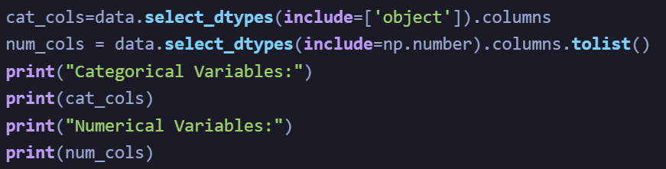
Before we do EDA, lets separate Numerical and categorical variables for easy analysis

Slide 16
EDA Univariate Analysis
Analyzing/visualizing the dataset by taking one variable at a time:
Data visualization is essential; we must decide what charts to plot to better understand the data. In this article, we visualize our data using Matplotlib and Seaborn libraries.
Matplotlib is a Python 2D plotting library used to draw basic charts we use Matplotlib.
Seaborn is also a python library built on top of Matplotlib that uses short lines of code to create and style statistical plots from Pandas and Numpy
Univariate analysis can be done for both Categorical and Numerical variables.
Categorical variables can be visualized using a Count plot, Bar Chart, Pie Plot, etc.
Numerical Variables can be visualized using Histogram, Box Plot, Density Plot, etc.
In our example, we have done a Univariate analysis using Histogram and Box Plot for continuous Variables.
In the below fig, a histogram and box plot is used to show the pattern of the variables, as some variables have skewness and outliers.

Slide 17
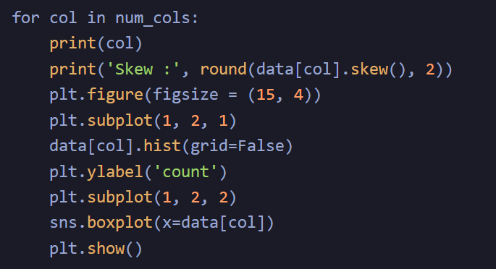

Slide 18
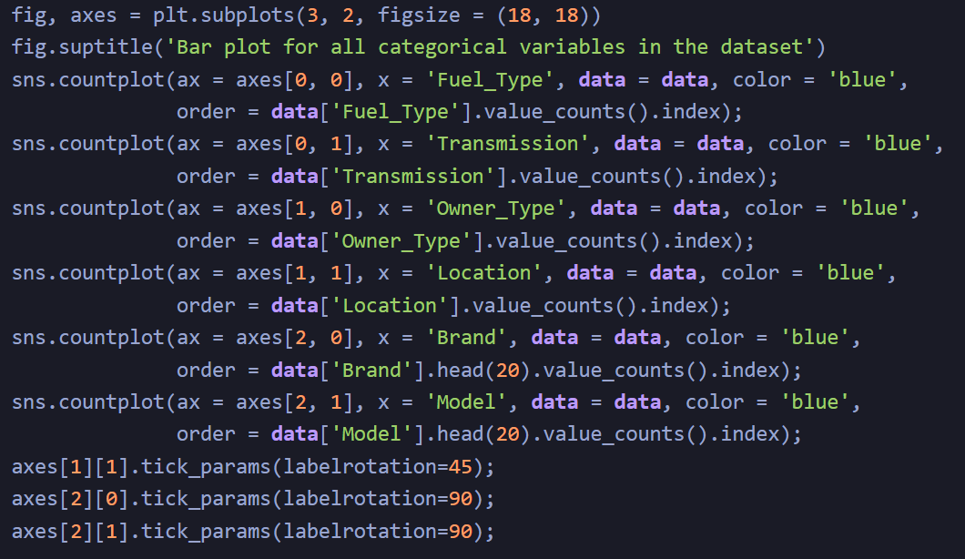
Categorical variables are being visualized using a count plot. Categorical variables provide the pattern of factors influencing car price

Slide 19
Data Transformation
Before we proceed to Bi-variate Analysis, Univariate analysis demonstrated the data pattern as some variables to be transformed.
Price and Kilometer-Driven variables are highly skewed and on a larger scale. Let’s do log transformation.
Log transformation can help in normalization, so this variable can maintain standard scale with other variables:

Slide 20
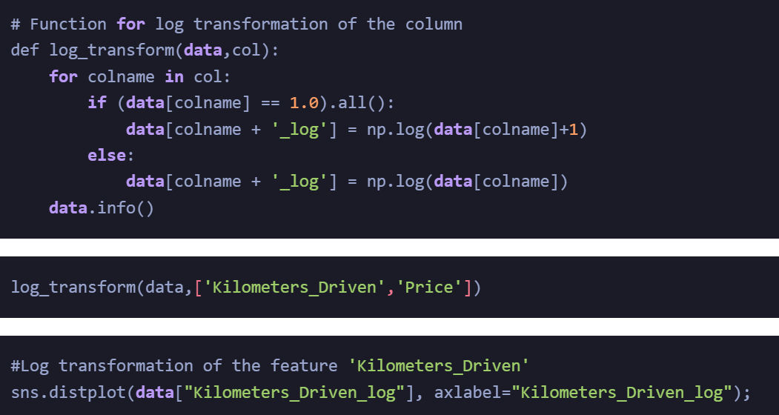

Slide 21
EDA Bivariate Analysis
Now, let’s move ahead with bivariate analysis. Bivariate Analysis helps to understand how variables are related to each other and the relationship between dependent and independent variables present in the dataset.
For Numerical variables, Pair plots and Scatter plots are widely been used to do Bivariate Analysis.
A Stacked bar chart can be used for categorical variables if the output variable is a classifier. Bar plots can be used if the output variable is continuous
In our example, a pair plot has been used to show the relationship between two Categorical variables.

Slide 22
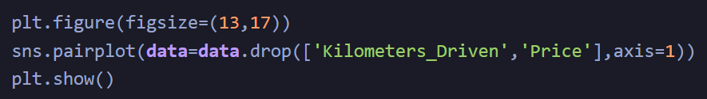

Slide 23
A bar plot can be used to show the relationship between Categorical variables and continuous variables

Slide 24
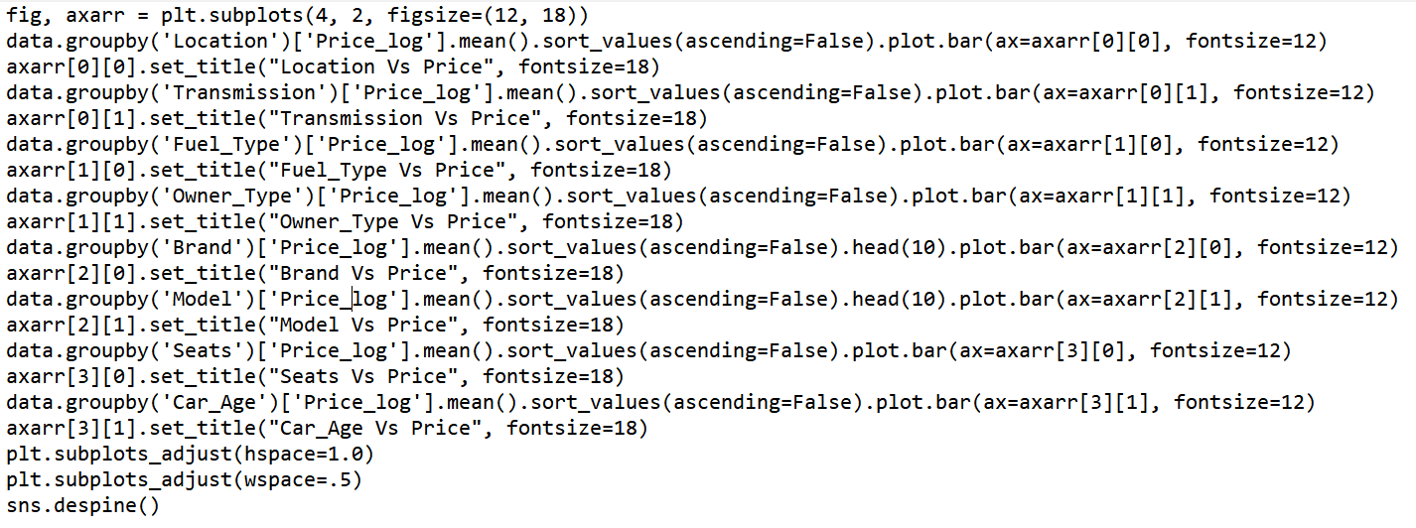
Code for Bar Plot

Slide 25
EDA Multivariate Analysis
As the name suggests, Multivariate analysis looks at more than two variables. Multivariate analysis is one of the most useful methods to determine relationships and analyze patterns for any dataset.
A heat map is widely been used for Multivariate Analysis
Heat Map gives the correlation between the variables, whether it has a positive or negative correlation.
In our example heat map shows the correlation between the variables.

Slide 26
Code For Multivariate Analysis.

